Slide 1

LADWP Supply Chain Procurement Improvement
Data 144/244 Final Project
Students: Zixuan Chen, Kayla Zhu, David Fan, Ziyi Wang, Luke Chen, Gugab Park
Professor Zachary Pardos
Fall 2022

Slide 2
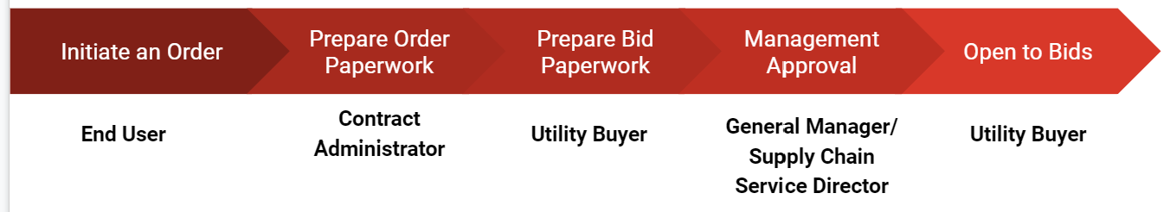
Introduction
Los Angeles Department of Water and Power (LADWP) is the nation’s largest municipal utility company serves more than four million residents and local businesses in the City of Los Angeles.
$756 million worth of requisition of equipment, tools, and services annually
Typical procurement process

Slide 3

Motivations
Two Types Ordering Mechanisms:
Single Purchase Orders(Spot POs):
Less process time and less paperwork
Price and Time(P&T) contracts:
Bulk umbrella contract
Only required to prepare for one bid invitation in 3-5 years
Order individual items as needed
Better and stable pricing
More reliable supplies
Problem: Find a way to optimize the supply chain to save processing time and money
Goals:
Task 1: Minimize Spot POs
Combine Repeat Spot POs into a P&T contract
Predict whether a Spot PO order will eventually become a P&T
Task 2: Predict future demands of items

Slide 4
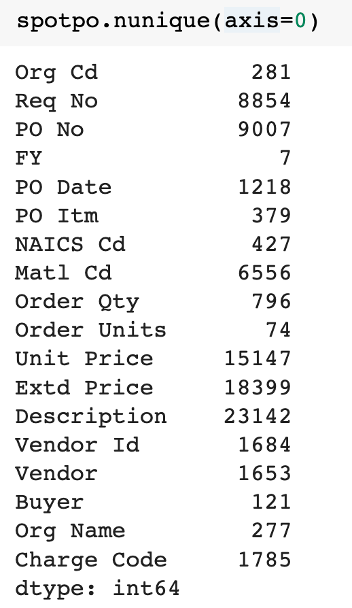
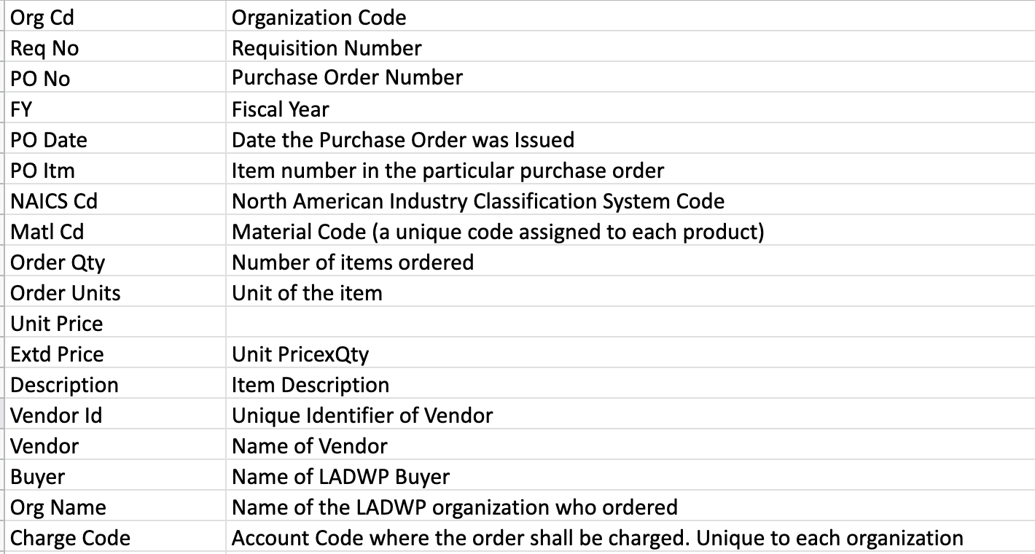
Datasets
Spot PO and P&T Contracts:
Find linkage between and identify what items are typical repeat purchase items and had been converted from SPOT PO to P&T contracts
Spot Label:
Subset of Spot PO (14,364 out of 31,705 instances)

Slide 5
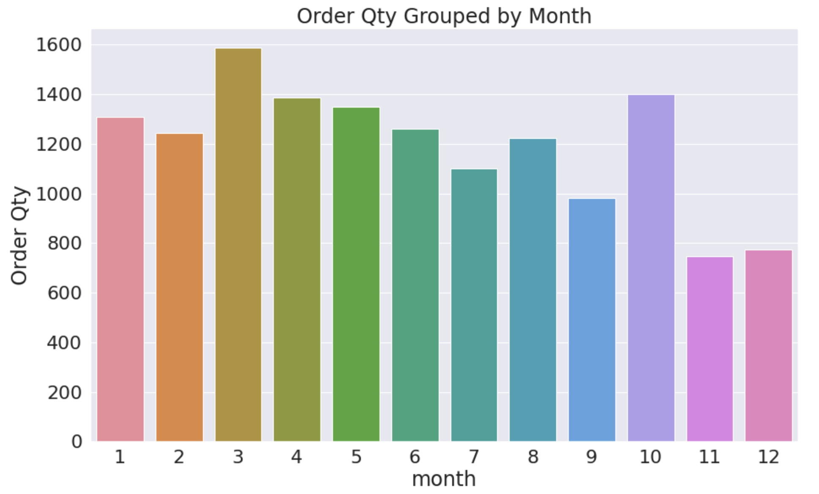
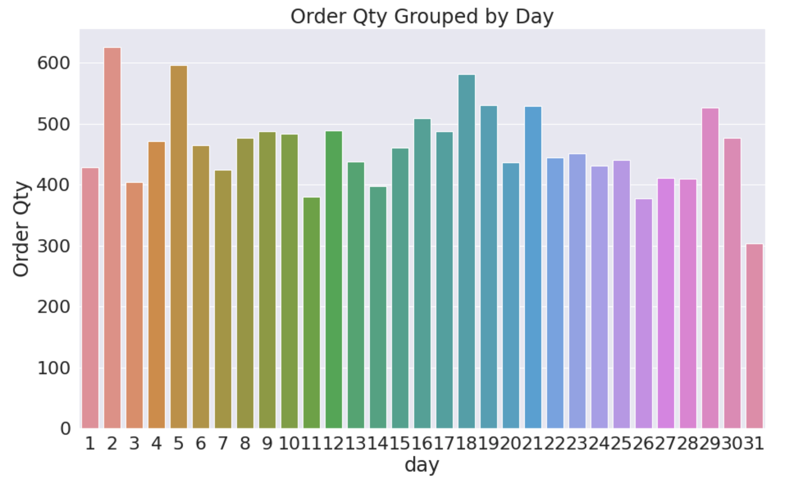
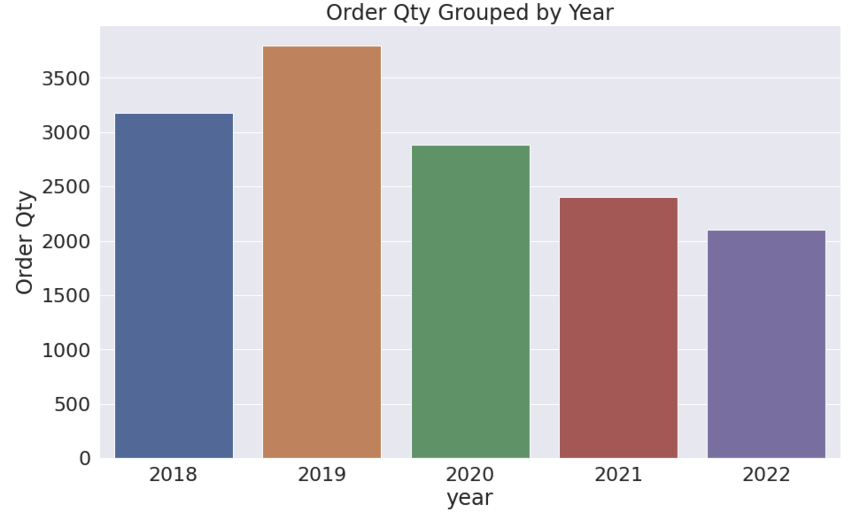
Exploratory Data Analysis
The Date Column:
Extract day, month, year from the Date column
Perform one hot encoding (OHE)
Generate visualizations

Slide 6
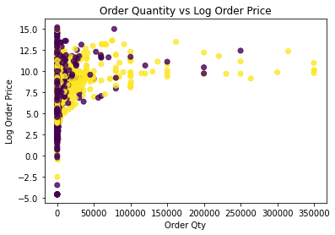
Exploratory Data Analysis
The Unit Price and Order Qty Column
Create a new column called Order Price
Order Price = Unit Price * Order Qty
Visualize the Log Order Price versus Order Qty
Standardize with minmax and standard scaling

Slide 7
Data Preprocessing
Data cleaning:
Remove dollar sign, commas, etc. on Unit Price
Convert from string to float
Fill in the NaN values with the median
Normalization: normalize Unit Price
Org Name: reduced from 281 to 36 based on function, location, and funding sources; OHE
Vendor Names: reduced from 1653 to 57 vendors based on who was awarded more than 10 contracts; OHE
Item description: two methods:
1) Extracted keywords from the purchase description with regex
2) NLP clustering (covered in the next two slides)

Slide 8
Unique Challenges in the Data Set
Main challenge:
Difficult to identify same and similar items
Other challenges:
Massive unique item descriptions (44,000 out of 106,000)
Lack of unique identifier for items (55% missing)
Different ways of describing same items
Abbreviations (e.g., breakers, brkr, etc)
Cutoff words (e.g., Elastimold, Elastimo, Elast)
Huge number of unique items due to small variations
Incomplete information
Notes:
There are some very challenging issues we faced with this dataset, the most prominent is the difficulty to identify same of similar items. Out of 106k instances, we have more than 44k unique item descriptions and less than half have a unique identifier. This is partially due to the huge variety of items and partially due to small variations in similar items, different users use different shorthand, put words in different orders. To make things even worse, we are also facing incomplete information since we were only given 1 line of the actual description.

Slide 9
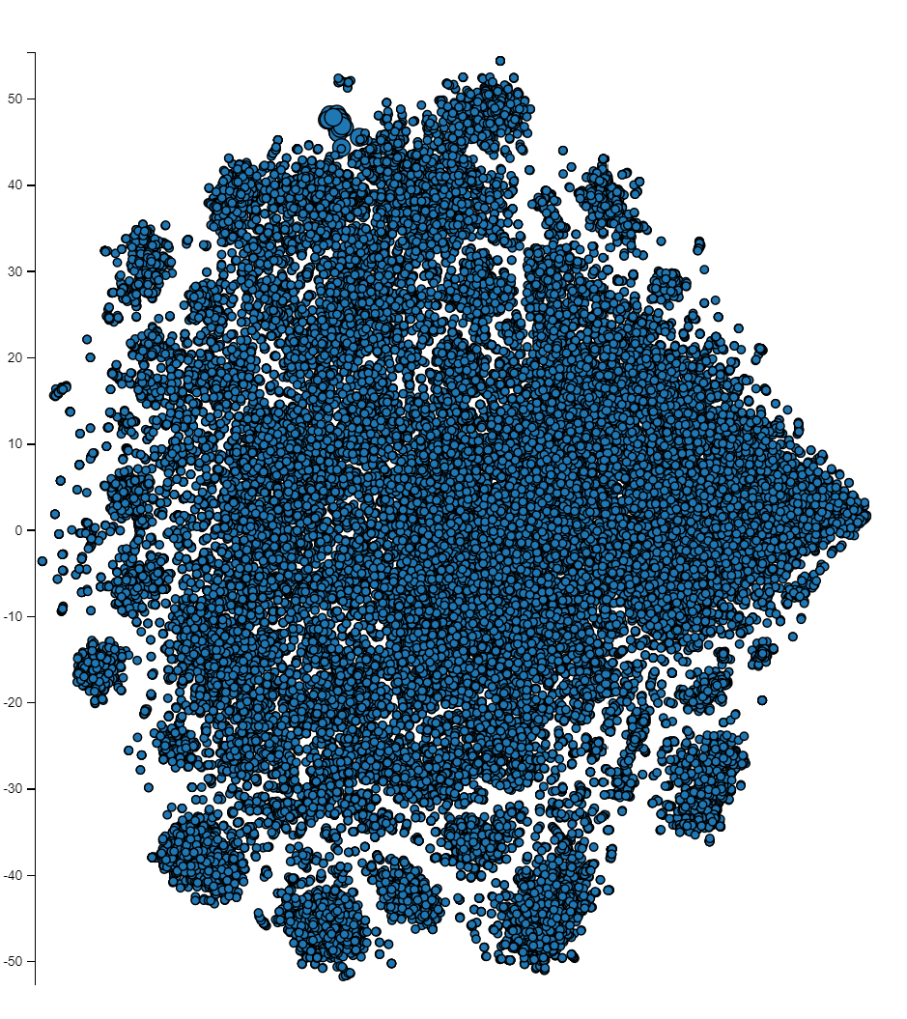
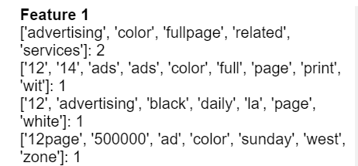

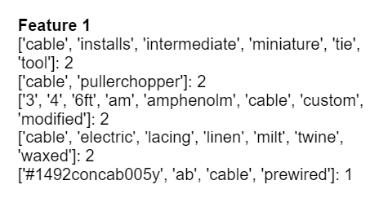
Preprocessing - Description Cont.
Step 1: Regex and Tokenization:
Customized stop words and punctuation list
Ordered tokenized words
Step 2: Models:
Word2Vec at word level
Doc2Vec at sentence level
Step 3: Clustering:
K Means: Predetermined K
Hierarchy: K based on euclidean distance
Step 4: Produced Labels as Item Description feature in lieu of Keywords approach
Notes:
For these reasons, it is extremely critical to identify and cluster similar items using NLP models. We had modeled both at word level and sentence level. Because we are dealing mostly with broken sentences and specialty terms, modeling at word level didn’t produce a good result. The clustering was a disaster. Just when we are about to give up, we found modeling at sentence level produced surprisingly meaningful clusters. Just pick a random spot on the top left for example, the model successfully identified similar newspaper ads descriptions even the key words are expressed differently. So we feel comfortable to use clustering labels in our model to replace key words.

Slide 10
Model - Neural Network
Features: Vendors, Organizations, Keywords, and Description Labels
Baseline training accuracy: 0.6245757549386476
Baseline testing accuracy: 0.6219979115906717
With Description Labels: suffered from overfitting
Without Description Labels: slightly better than baseline accuracy
Makes sense since many purchases can be classified as ‘Repeat’ only if they meet two or three conditions
 | True Positive Rate (TPR) | Training accuracy | Testing accuracy | Precision | False Positive Rate (FPR)
with description labels | 0.896 | 0.899 | 0.554 | 0.940 | 0.0578
without description labels | 0.762 | 0.661 | 0.651 | 0.714 | 0.305

Slide 11
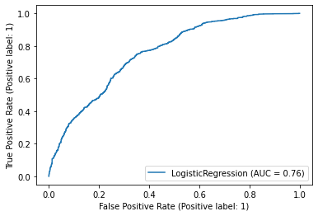
Model - Logistic Regression
Features: Unit Price, Quantity, Extended Price, Dates, Vendors, Organizations, Keywords, and Description Labels
About 8,000 features after OHC vs 14,364 data points
Base 63.4% accuracy rate without extensive feature engineering
Training: 73.5% vs Test: 72.7%
89.2% True Positive Rate

Slide 12
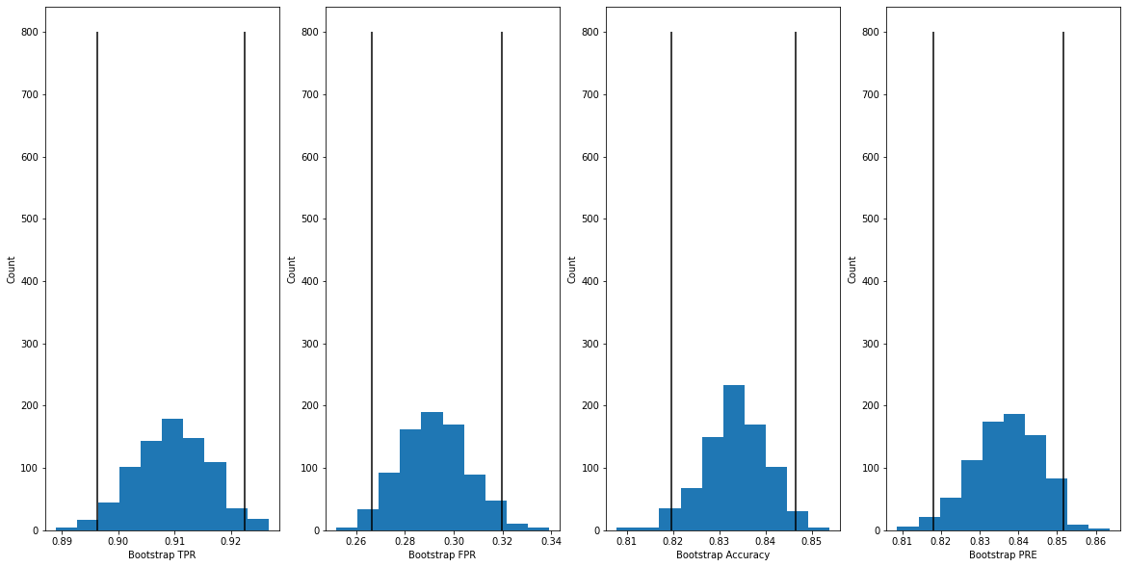
Model - Decision Tree
3 different models using:
keywords only
description label only
both keywords and description label
Test accuracy w/o bootstrapping: 0.8332753219631047
Bootstrapping with n = 800
Depending on whether we want to optimize TPR, FPR, accuracy, or precision, the model we use will slightly differ
 | TPR | Accuracy | Precision | FPR
keywords only | 0.891377 | 0.826783 | 0.839940 | 0.279477
label only | 0.909575 | 0.833369 | 0.836734 | 0.292003
both keywords and label | 0.9069080 | 0.838174 | 0.844425 | 0.274905
Notes:
Features: Vendors, Organizations, Keywords, and Description Labels

Slide 13
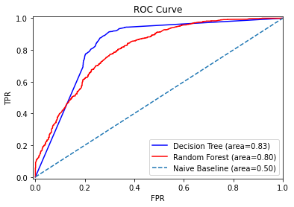
Model - Random Forest
Features: Unit Price, Quantity, Extended Price, Vendors, Organizations, Keywords, and Description Labels
Training set accuracy: 0.9419545731441998
Testing set accuracy: 0.8297946397493908

Slide 14
Results - Task 1
Best model: Decision Tree
Highest accuracy and precision
Lowest false positive rate
 | TPR | Accuracy | Precision | FPR
Neural Network | 0.762 | 0.651 | 0.714 | 0.305
Logistic Regression | 0.892 | 0.727 | 0.729 | 0.33
Random Forest | 0.910 | 0.830 | 0.832 | 0.302
Decision Tree | 0.907 | 0.838 | 0.844 | 0.275
Notes:
AUC for decision tree is larger too
RF TPR is high, but FPR is also high
DTC TPR is just slightly lower but FPR is lower by a lot more

Slide 15
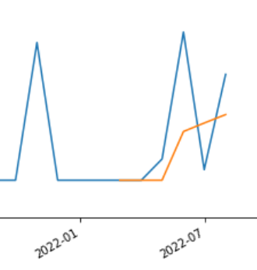
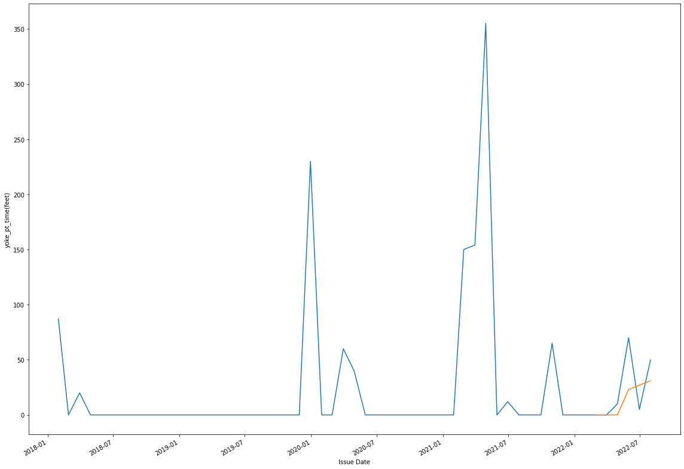
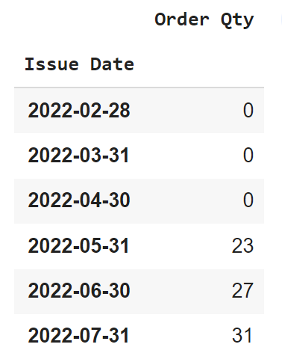
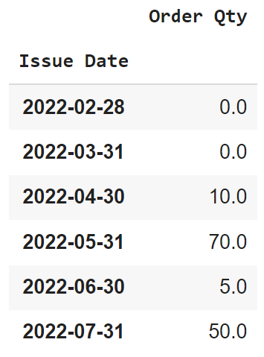
Model - Time Series Forecast
Application:
Determine whether to convert a SPOT to P&T
Determine when to issue a new P&T contract
Data:
Historical order data from both P&T and SPOT
Timestamp dates and sum qty by months
Normalize qty using standardscaler
Model:
RNN LSTM
100 epoches
activation = relu
optimizer = adam
Prediction:
Possible number of orders in 6 months (proxy: # of months)
Qty in each order
Prediction vs Actual
Notes:
After an item was identified as a potential P&T contract item, we would need to forecast future demand. An RNN LSTM model is used in this project. Using both historical P&T and SPOT order data, we can predict possible number of orders and qtys in each order. Here we use the number of months as a proxy of the number of orders. On the right is an example. Based on this information, a final determination can be made which will be explained in detail in the next slide.

Slide 16



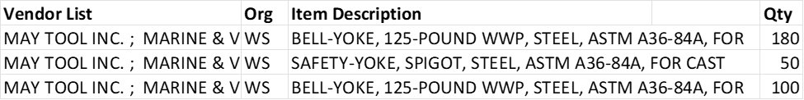
Application
Utility Buyer (UB) and Contract Administrator(CA) handle the order and contract
Various End Users (Employees) put order request info of items and quantities

Slide 17
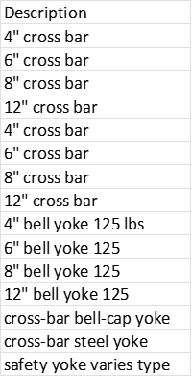

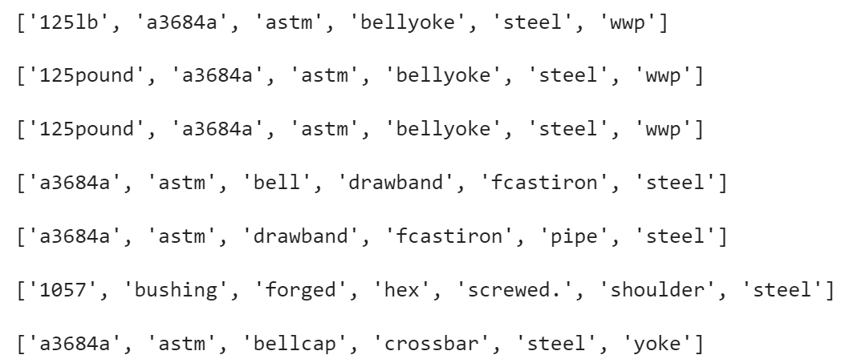
CA’s Order Info from User A
CA/UB’s Final Decision
(Future ML opportunity)
Single
SPOT
System Predictions for CA/UB
Item Description
P&T?
Large P&T
Y
BELL-YOKE, 125-POUND WWP, STEEL, ASTM A36-84A
Y
Y
Y
predicts # of orders in the next 6 months (=4 orders)
Predicts item quantities in the next 6 months
Y
Y
Y
Y
predicts if item should be a P&T order
produces a list or related items for UB and CA to consider
Notes:
Step1: End user place an order in the system with several items
Step2a: System produce a list of related items based on cosine similarity and
Step2b:recommend if they should have been a P&T purchase based on a group of features (eg. possible vendor list and end user’s org name, etc)
Step3: System predict # of orders in 6 months and qty in 6 months
Step4: Using this information buyer and Contract Administrator identify P&T contract opportunities (future ML work) and group items into a 3 year contract
Step5: Identify cost savings
Step6: Buyer proceed as 3 year bid or continue process SPOT

Slide 18
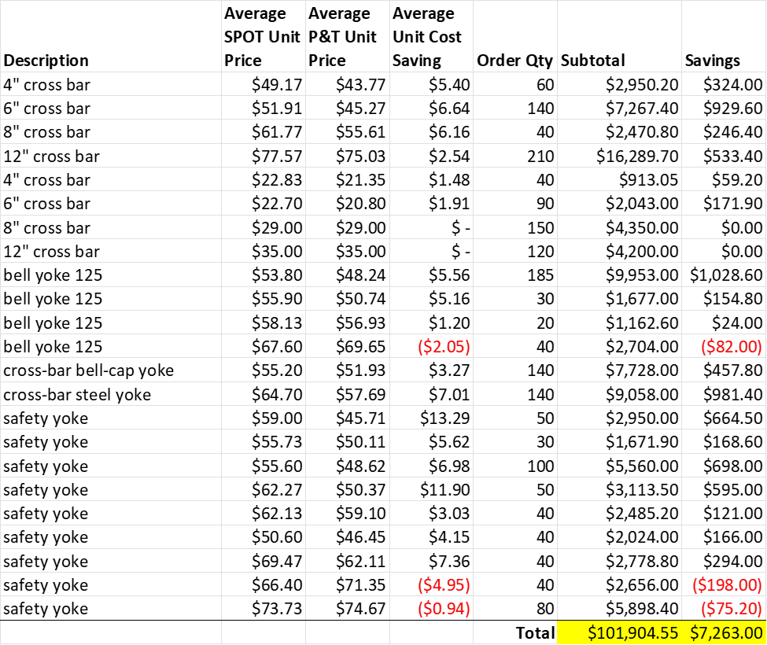
Example of Case Savings
In this example, a 3 year contract (worth $102k) was placed after 3 different SPOT POs. If we had a P&T contract set-up initially, we would have saved:
Labor Savings = $62,400*
Price savings = $7,263* (7%)
Total savings = $70,063*
See disclaimer
*Disclaimer: all costs are estimated for the DMA244 purpose only. It shall not be used to make any inference outside this course.
Notes:
$70/hr for contract admin
55 - utility buyer

Slide 19
Limitations and Future Work
Factor in other variables to change the scope of analysis:
Ex: “Days needed by” column (urgent items)
Without time constraint
Try GridSearchCV to find multiple optimal parameter values
Try boosting and stacking
Non-stationary time series data for some items
Use full technical documents as a corpus to train the NLP model instead of one line description
Use machine learning to automate the last step from slide 18 (final grouping decision)
Find a way to generalize and use for other organizations
See which metric to optimize to decide which final model to use
Note: these are opportunities for improvement or further analysis, but do not guarantee an improvement in performance
Notes:
It’s not ready to be used in the real world
ML for slide 21:
Learn what items are grouped together in P&T
right now, we know what items are P&T but we don’t know what items are grouped together
Ex: Cross bar and bell yoke aren’t related/similar to each other
After we produce list of similar items, CA and UB make decision on what to include
As of now, this process is manually done by a human
In the future, we hope that it can be automated

Slide 20
Impact
In the subset data* we studied, there are a total of 8,964 items in 3,462 SPOT orders ($95 milion worth) qualify for P&T contract. With 90% TPR, our model would have been able to avoid 3,116 SPOT purchases, resulting in labor savings of $18*-$34* million (dependent on the # of sequential SPOT orders) and a price saving of $6* million.
* approximately 50% of past 5 years
see disclaimer
*Disclaimer: All costs are estimated for the DMA244 purpose only. It shall not be used to make any inference outside this course.

Slide 21
Thank you!

